Slide 1
Maths
Unit 2 – Numbers and Sequences
04.09.2026
WALT:
6Ni.06 – Understand common multiples and common factors.

Slide 2



WALT: Understand common multiples and common factors.
I can find common multiples of numbers using a 100 square.
I can use a Venn diagram to classify numbers and find common multiples and common factors.
I can answer word questions about factors and multiples.

Slide 3
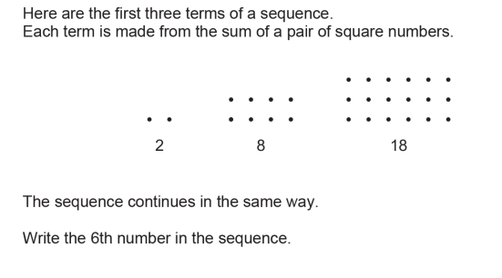
Retrieval Practice
WALT: Understand common multiples and common factors.

Slide 4
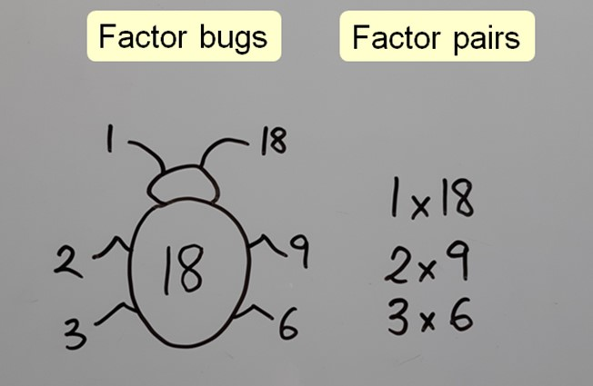
Starter -
WALT: Understand common multiples and common factors.
Write all the factors of 12.
Write all the multiples of 12.
Can you do it? Why / why not?

Slide 5
We are going to be part of a “mathematical orchestra”.
WALT: Understand common multiples and common factors.

Slide 6
I will be the conductor and count the beat.
WALT: Understand common multiples and common factors.
Table 1 – Stand up whenever I say a multiple of 1.
Table 2 - Stand up whenever I say a multiple of 2.
Table 3 - Stand up whenever I say a multiple of 3.
Table 4 - Stand up whenever I say a multiple of 4.
Table 5 - Stand up whenever I say a multiple of 5.
Table 6 - Stand up whenever I say a multiple of 6.

Slide 7
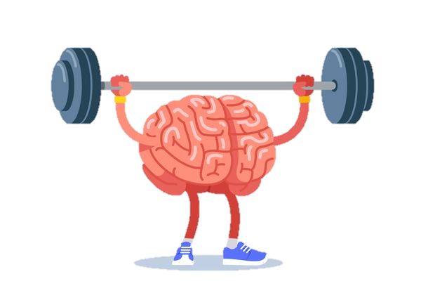
WALT: Understand common multiples and common factors.
How many tables will stand up when I say 24?
How do you know?
What is the first number where all 6 tables will stand up? How do you know?

Slide 8
The activity we have just done demonstrated common multiples and common factors.
WALT: Understand common multiples and common factors.
Common Multiples – Multiples that are shared by more than one number.
For example 10 is a common multiple of both 2 and 5.
Common Factors – Factors that are shared by more than one number.
For example 10 is a common factor of both 20 and 30.

Slide 9
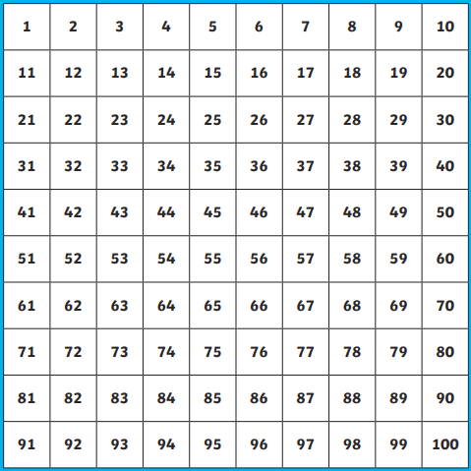
We can use a 100 square to help us find common multiples.
WALT: Understand common multiples and common factors.
Use one colour to circle all the multiples of 5.
Use a different colour to circle all the multiples of 6.

Slide 10
We can use a 100 square to help us find common multiples.
WALT: Understand common multiples and common factors.
Let’s find the common multiples of 5 and 6.

Slide 11

Check your understanding
WALT: Understand common multiples and common factors.
What are the common factors of 6 and 15?
Write a number is a common multiple of 4 and 7?
3) Ms. Colette and Ms. Anh both enjoy playing basketball. If they both to basketball training on the 1st of June and Ms. Colette goes once every 3 days and Ms. Anh goes once every 4 days. How many times will they play basketball on the same day in June in total?

Slide 12
Check your understanding
WALT: Understand common multiples and common factors.
What are the common factors of 6 and 15?
1, 3
2) Write a number is a common multiple of 4 and 7?
28, 56, 84, 112, 140…

Slide 13
WALT: Understand common multiples and common factors.
3) Ms. Colette and Ms. Anh both enjoy playing basketball. If they both go to basketball training on the 1st of June and Ms. Colette goes once every 3 days and Ms. Anh goes once every 4 days. How many times will they play basketball on the same day in June in total?

Slide 14
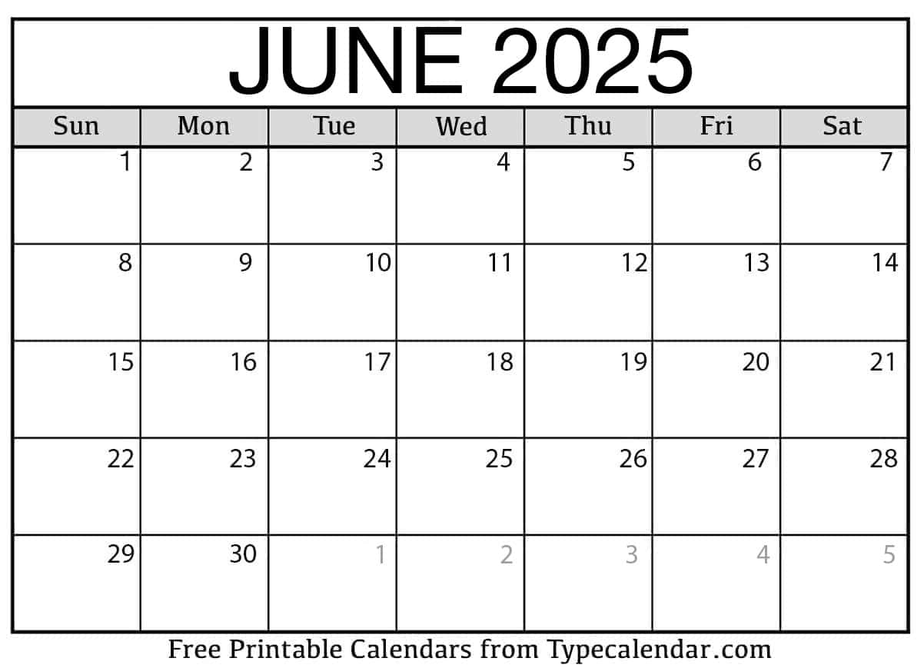
WALT: Understand common multiples and common factors.
Ms. Colette
Ms. Anh

Slide 15
WALT: Understand common multiples and common factors.
3) Ms. Colette and Ms. Anh both enjoy playing basketball. If they both to basketball training on the 1st of June and Ms. Colette goes once every 3 days and Ms. Anh goes once every 4 days. How many times will they play basketball on the same day in June in total?
3 times

Slide 16
WALT: Understand common multiples and common factors.
Ms. Colette
Ms. Anh

Slide 17
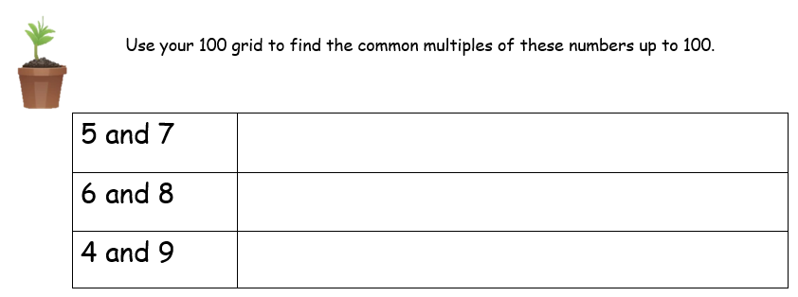
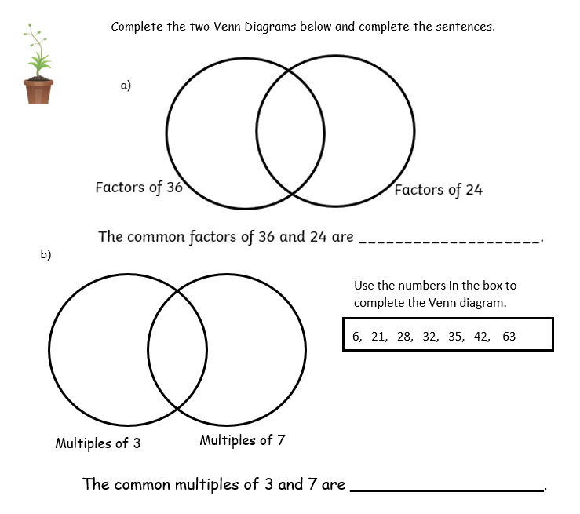
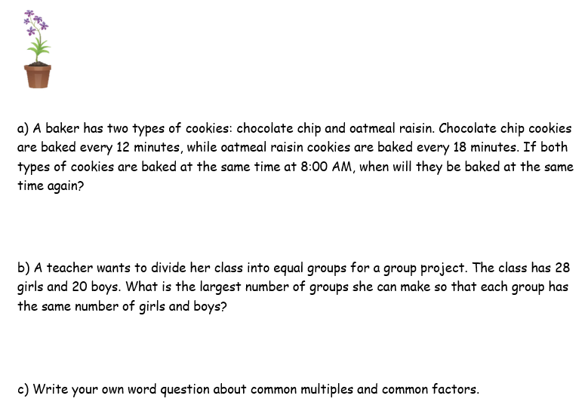
WALT: Understand common multiples and common factors.

Slide 18
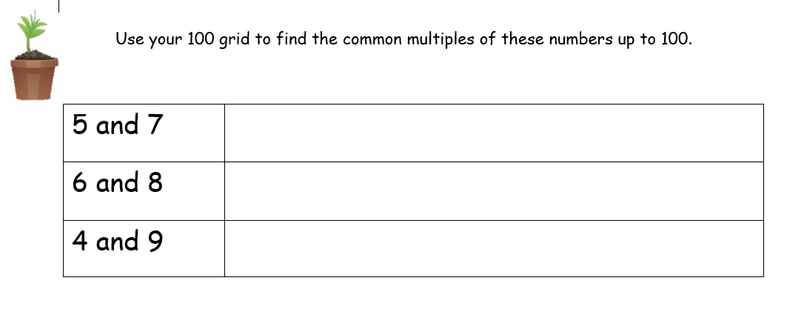
WALT: Understand common multiples and common factors.
35, 70
24, 48, 72, 96
36, 72

Slide 19
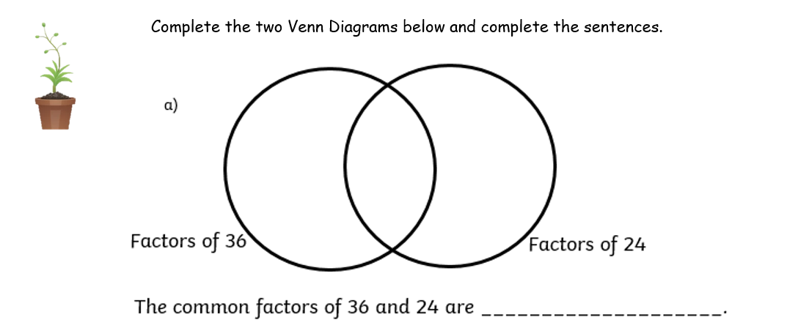
WALT: Understand common multiples and common factors.
16
5
13
17
7
9
4
8
14
1
2
6
10
15
18
3
11
12
19 … etc
1, 2, 3, 4, 6, 12

Slide 20
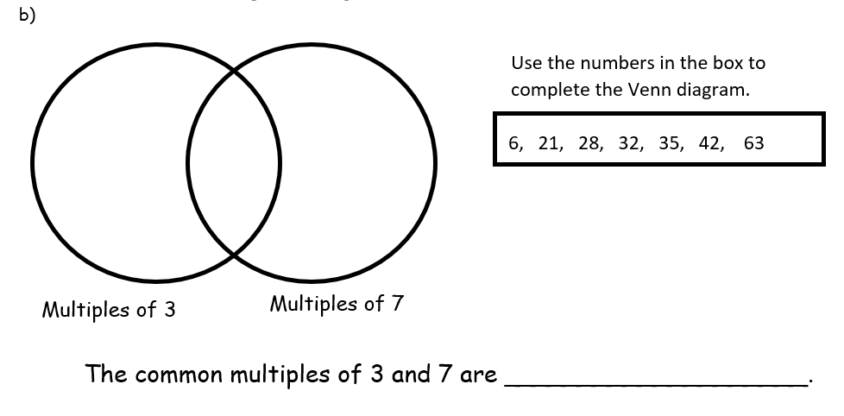
WALT: Understand common multiples and common factors.
6
21
28
42
63
35
32
21, 42, 63

Slide 21
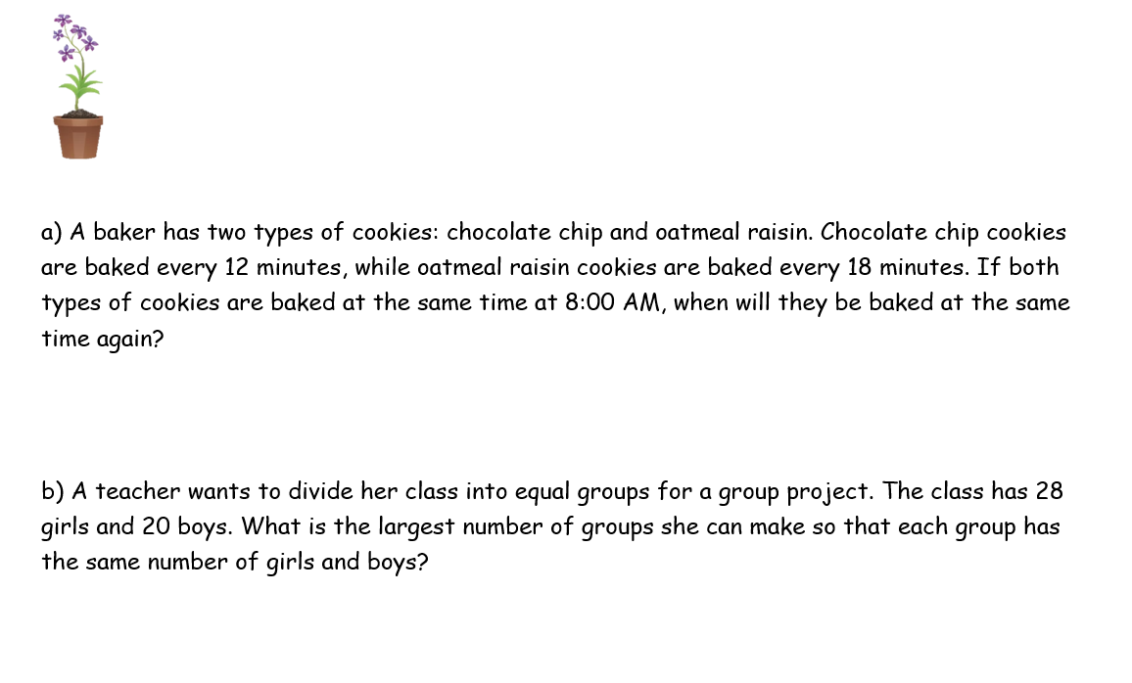
WALT: Understand common multiples and common factors.
8:36 am
4

Slide 22
WALT: Understand common multiples and common factors.
I can find common multiples of numbers using a number square.
I can use a Venn diagram to classify numbers and find common multiples and common factors.
I can answer word questions about factors and multiples.

Slide 23
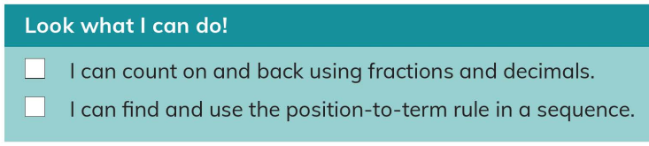
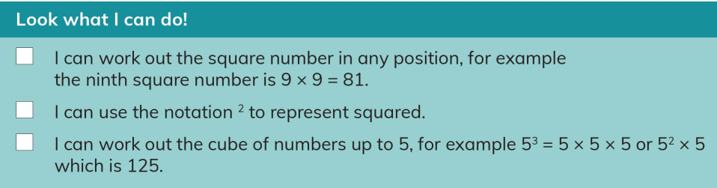
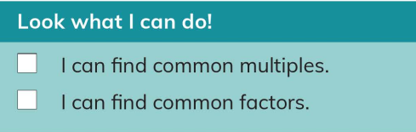
Plenary
WALT: Understand common multiples and common factors.

